Slide 1
Health First Hospitals
Broker Training
10142021

Slide 2
Module Description
This module is designed to review:
Health First’s Holmes Regional Medical Center
Health First’s Cape Canaveral Hospital
Health First’s Palm Bay Hospital
Health First’s Viera Hospital

Slide 3
Health First’s Holmes Regional Medical Center

Slide 4
Health First’s Holmes Regional Medical Center
Hospital Background Information
514-bed hospital
Located in Melbourne, it is the premier tertiary hospital with a 500+ medical staff team
The only state-accredited trauma center in Brevard and Indian River counties that provides:
24/7 trauma care
Rapid patient transport via First Flight aeromedical helicopter
Additional services include:
53-bed Emergency Department
Birthing suites with a Level II neonatal ICU (NICU) for our tiniest patients
Orthopedic services
Cardiovascular services and neurology services

Slide 5
Health First’s Holmes Regional Medical Center
Proud to be the first hospital in Brevard to offer state-of-the-art robotics-assisted surgery for urology, prostate and gynecological conditions, advanced anterior hip replacement and reverse shoulder surgeries.
As a Primary Stroke Center, our goal is to transport, assess, diagnose and treat each stroke patient within three hours of the onset of their symptoms. We also offer advanced, life-changing Interventional Neuro-Radiology procedures for advanced stroke treatment found nowhere else in Brevard.
Awarded with the “Get with the Guidelines” Gold Award by the American Stroke Association.

Slide 6
Health First’s Holmes Regional Medical Center
Services:
The Birth Suites
Bariatrics
Cardiac Rehabilitation Services
Cardiothoracic
Diabetes
Emergency Room
Heart Care
Neurosciences
Interventional Neuroradiology/Y90
Maternity
Neurosciences
Oncology
Orthopedics
PCI
Robotics Trauma Center
Urogynecology
Surgical
Vital Watch
Women & Children

Slide 7
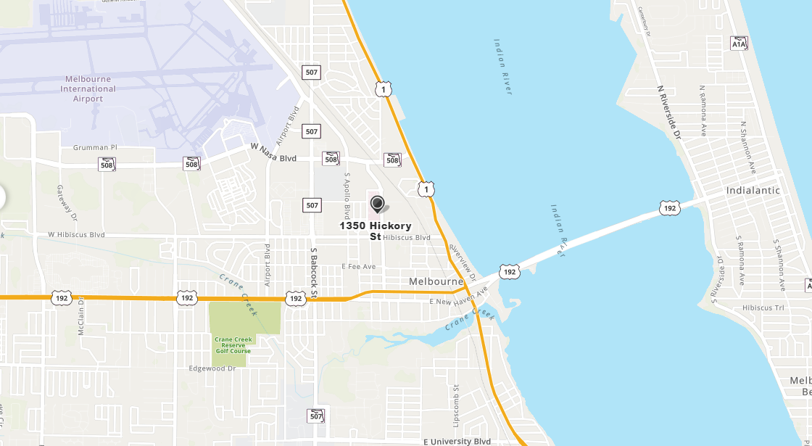
Health First’s Holmes Regional Medical Center
Address
1350 South Hickory St. Melbourne, Florida 32901
Phone
321.434.7000
For more information,
visit HF.org

Slide 8
Health First’s Cape Canaveral Hospital

Slide 9
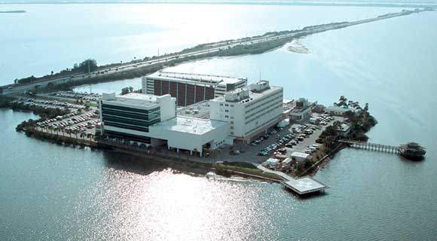
Health First’s Cape Canaveral Hospital
Hospital Background Information
Part of the Health First Integrated Delivery Network (IDN), Cape Canaveral Hospital is a non-profit hospital that reinvests any profits into programs and services for the community.
Health First’s Cape Canaveral Hospital opened in 1962 as a 50-bed hospital. It is now a 150-bed hospital with a more than 240-member Medical Staff.

Slide 10
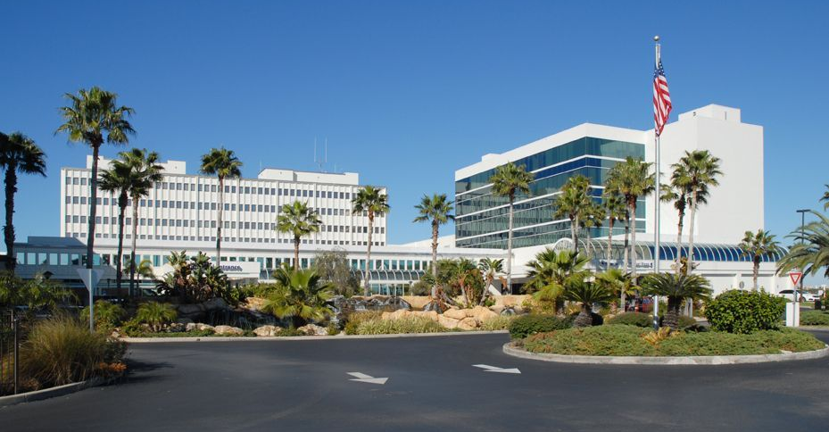
Health First’s Cape Canaveral Hospital
Health First’s Cape Canaveral Hospital offers beautiful water views from its Birthing Care Center.
The Women’s Diagnostic Center features state-of-the-art, personalized services, including Digital Mammography, Ultrasound, Stereotactic Breast Biopsy and MRI breast imaging, and is accredited by the American College of Radiology and the U.S. Food and Drug Administration.
Cape Canaveral Hospital also boasts a 21-bed Level II Emergency Department and an adjoining six-story Medical Plaza that includes physician's offices, a conference center, pre-operative testing, outpatient registration for laboratory testing and same-day surgery.

Slide 11
Health First’s Cape Canaveral Hospital
Services:
Bariatrics
Cardiothoracic
Cardiovascular Lab
Diabetes
Emergency Room
Full Medical & Surgical Capabilities
Healthcare Resource Center
Advanced Cancer Care & Education
The Birthing Care Center
Neurosciences
Orthopedics
PCI
Urogynecology
Surgical

Slide 12
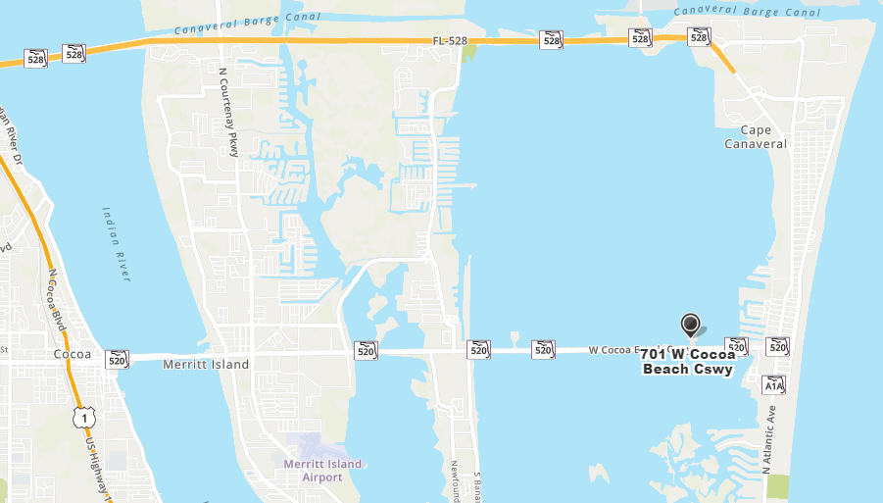
Health First’s Cape Canaveral Hospital
Address
701 W. Cocoa Beach
Causeway
Cocoa Beach, Florida 32931
Phone
321.799.7111
For more information,
visit HF.org

Slide 13
Health First’s Palm Bay Hospital

Slide 14
Health First’s Palm Bay Hospital
Hospital Background Information
152-bed hospital, with a more than 195-member Medical Staff
The first Brevard hospital to offer thoracic endograft surgery
Palm Bay Hospital serves our community with a 22-bed Emergency Department treating 38,000+ emergency cases a year.
Brevard’s first Hospice patient facility, the William Childs Hospice House, is located in a secluded wooded area on the hospital campus.

Slide 15
Health First’s Palm Bay Hospital
Services:
Cardiothoracic
Bariatrics
Diabetes
Emergency Room
Full Medical & Surgical Capabilities
Heart Services
Lab Services
Neurosciences
Oncology
Orthopedics
Robotics
The Center for Joint Replacement
Urogynecology

Slide 16
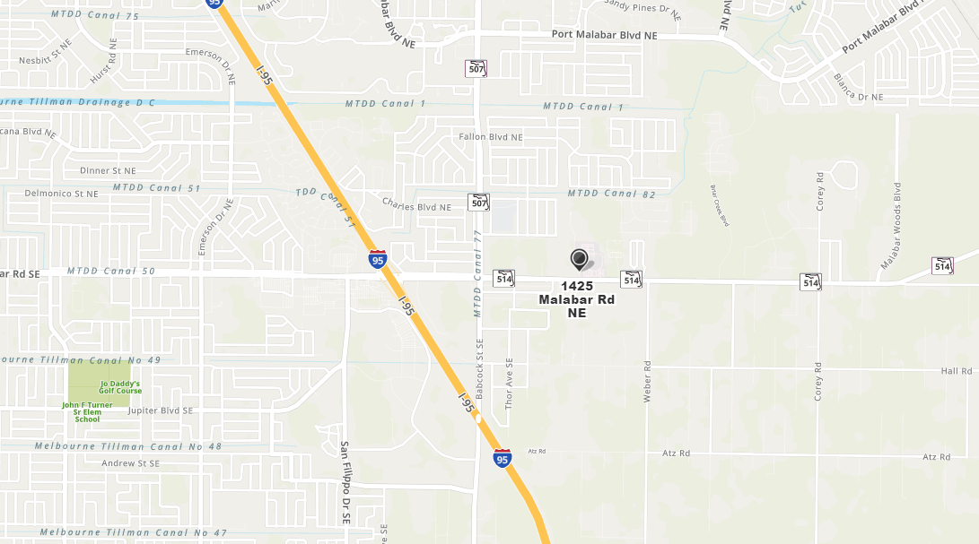
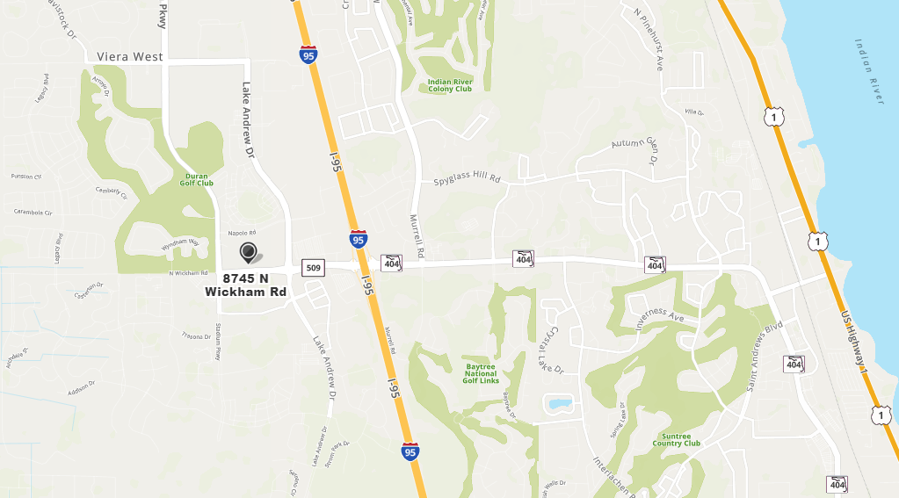
Health First’s Palm Bay Hospital
Address
1425 Malabar Road NE
Palm Bay, Florida 32907
Phone
321.434.8000
For more information,
visit HF.org

Slide 17
Health First’s Viera Hospital

Slide 18
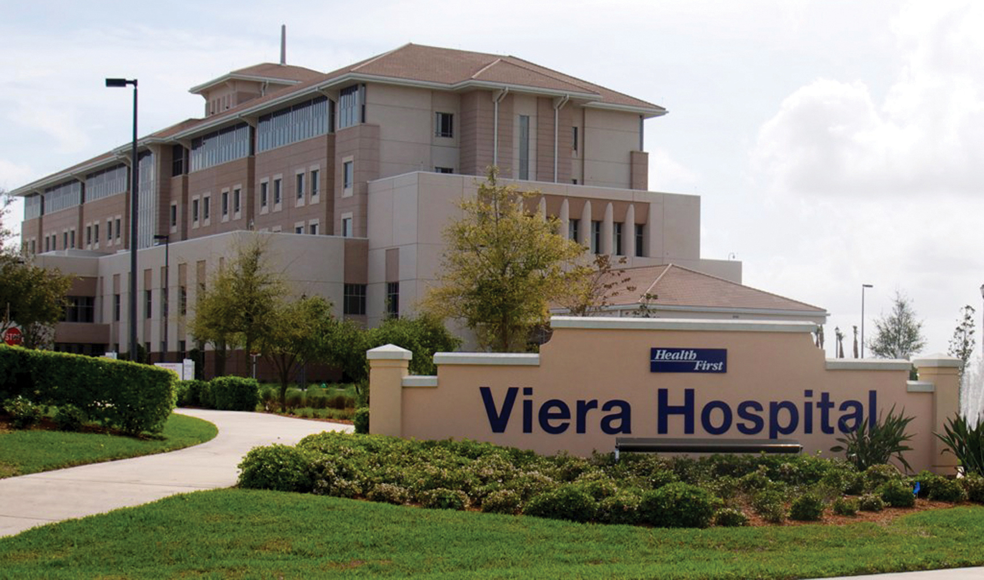
Health First’s Viera Hospital
Hospital Background Information
Viera Hospital opened in April 2011
50-acre healthcare campus
Viera Hospital (5 Floors)
Viera Medical Plaza (3 Floors)
Pro-Health Fitness Facility (2 Floors)
84 all-private-bed facility with plans to expand to 300+ beds
Orthopedic and bariatric specialization

Slide 19
Health First’s Viera Hospital
Services:
Bariatrics
Cardiothoracic Cancer Services
Emergency Room
First Flight
Full Medical & Surgical Capabilities
Full-Service Laboratory
Neurosciences
Outpatient Services
Orthopedics
Robotics
Urogynecology

Slide 20
Health First’s Viera Hospital
Address
8745 N. Wickham Road
Melbourne, Florida 32940
Phone
321.434.9000
For more information,
visit HF.org

Slide 21
Thank You!

